Slide 1

DSA
Week 8
Trees
Data Structures and Algorithms (DSA)
Prescribed Module/Elective
Diploma in IT, ISF, FI
Year 2 (2018/19), Semester 4

Slide 2
Topics
Introduction to Trees
Tree Terminology
Types of Trees
Binary Trees
Binary Tree Traversals
Binary Search Trees
Operations of a Binary Search Tree

Slide 3
References
1. Data Abstraction and Problem Solving with C++ 5th Edition
☞ chapter 10 (Trees)
2. Sample Program
☞ MEL

Slide 4
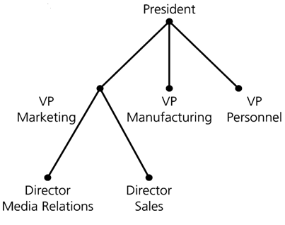
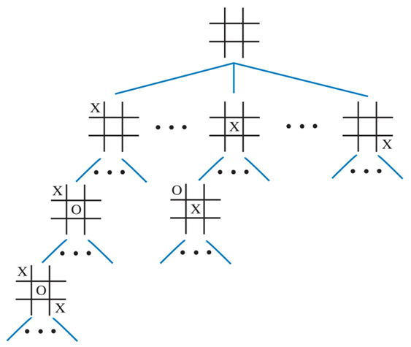
1. Introduction to Trees
A tree is a data structure that organizes data in hierarchical order.
e.g. organizational chart , game tree, family tree, file directories, expression trees, decision trees

Slide 5
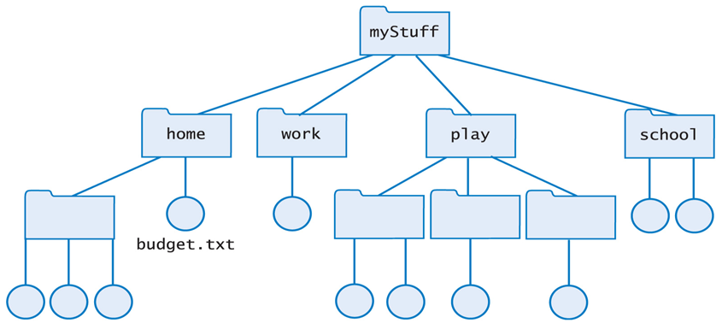
Example - File Directories

Slide 6
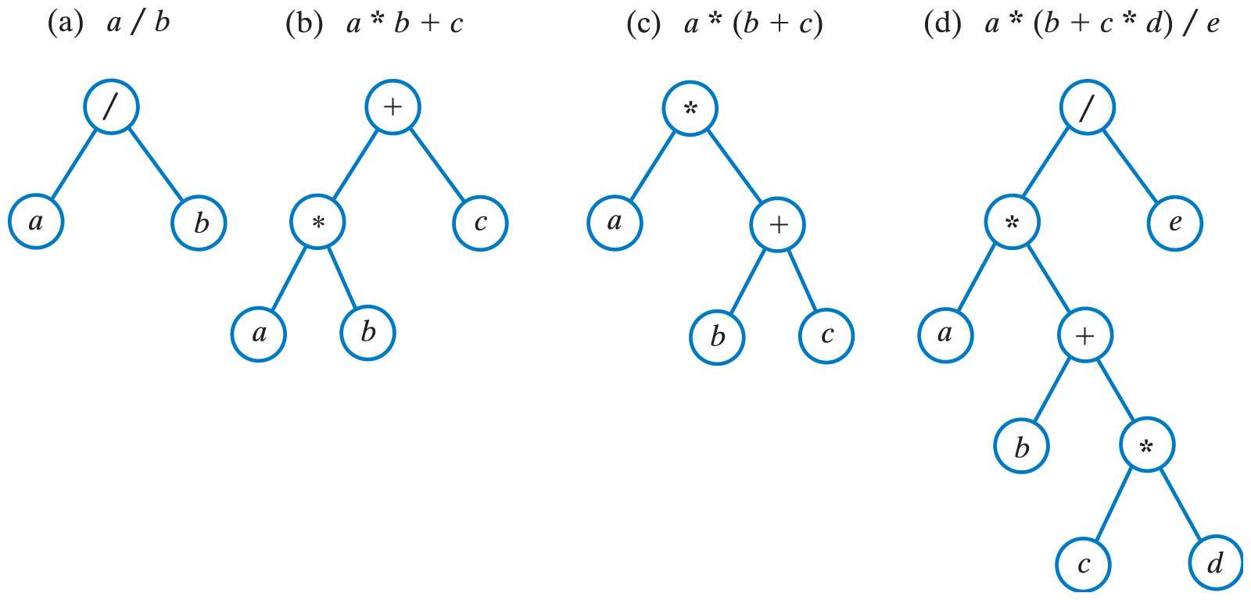
Example – Expression Trees

Slide 7
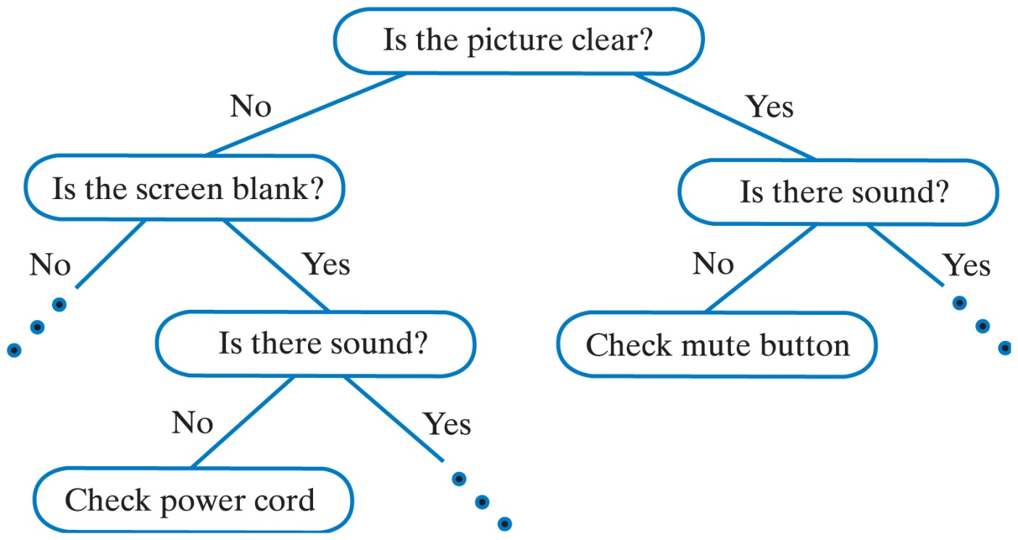
Example – Decision Trees

Slide 8
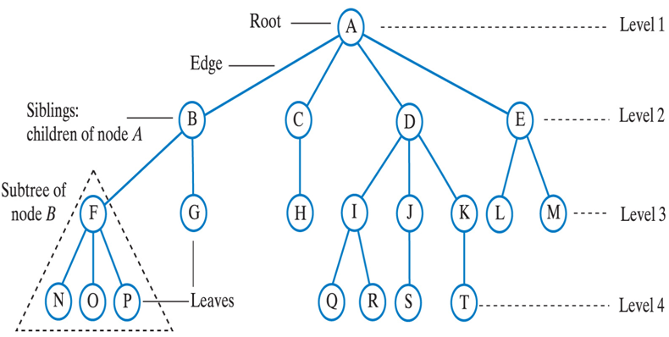
2. Tree Terminology
Trees are composed of nodes and edges

Slide 9
Tree Terminology
Root
- the node at the top of the tree
Leaf
- a node with no children
Level
- the number of generations from the root
Height
- the number of levels in the tree
Parent
- node with nodes (children ) below it
Children
- nodes below a given node (parent)

Slide 10
3. Types of Trees
General Tree
a tree with any number of subtrees
Binary Tree
a tree with at most 2 subtrees
Binary Search Tree
a binary tree that is ordered
i.e. values on the left subtree < value of parent
values on the right subtree > value of parent
AVL Tree
a binary search tree that is balanced
the heights of any node’s two subtrees differ by at most 1

Slide 11
4. Binary Trees
A binary tree is a tree that has at most 2 subtrees.
e.g. decision trees

Slide 12
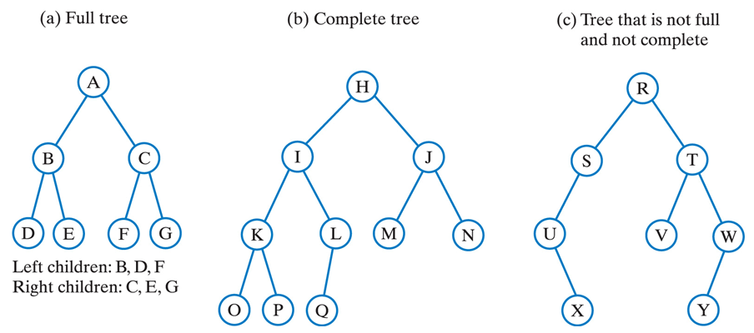
Binary Trees - Examples

Slide 13

Structure of a Binary Node
// BinaryNode.h
struct BinaryNode
{
ItemType item; // data item
BinaryNode *left; // pointer pointing to left subtree
BinaryNode *right; // pointer pointing to right subtree
};

Slide 14
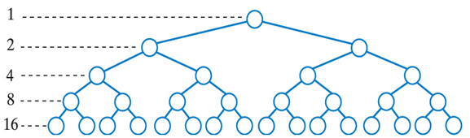
Full Binary Trees
A binary tree is full if every node (except the leaf nodes) has two children
The number of nodes in a full binary tree of height h, n = 2^{h} – 1
The height of a full binary tree with n nodes that is full is h = log₂(n + 1)

Slide 15
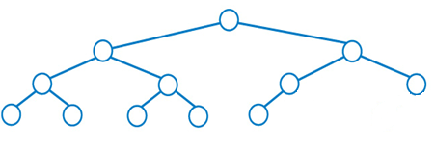
Complete Binary Trees
A binary tree is complete if - it is full to all the levels except the last level and
- the last level is filled from left to right

Slide 16
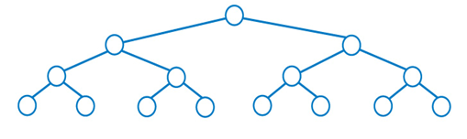
Balanced Binary Trees
A binary tree is balanced if the heights of any node’s two subtrees differ by at most 1

Slide 17
Traversals of a Binary Tree
Traversing a binary tree visits each node in the binary tree.
Traversals of a Binary Tree
Inorder : Left-Root-Right
Preorder : Root-Left-Right
Postorder : Left-Right-Root
Level order : Level by Level

Slide 18
Inorder Traversal - Algorithm
void inorder(BinaryNode *t)
If (t is not empty) { traverse(Left subtree of t) // recursive process node traverse(Right subtree of t) // recursive }

Slide 19
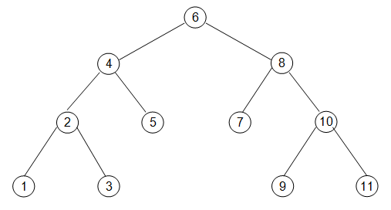
Inorder traversal
Inorder : Left-Root-Right
What is the sequence in which the nodes are visited?
Notes:
1 2 3 4 5 6 7 8 9 10 11

Slide 20
Preorder traversal
Preorder : Root-Left-Right
What is the sequence in which the nodes are visited?
Notes:
6 4 2 1 3 5 8 7 10 9 11

Slide 21
Postorder traversal
Postorder : Left-Right-Root
What is the sequence in which the nodes are visited?
Notes:
1 3 2 5 4 7 9 11 10 8 6

Slide 22
Level order traversal
Level order : Level by Level
What is the sequence in which the nodes are visited?
Notes:
6 4 8 2 5 7 10 1 3 9 11

Slide 23
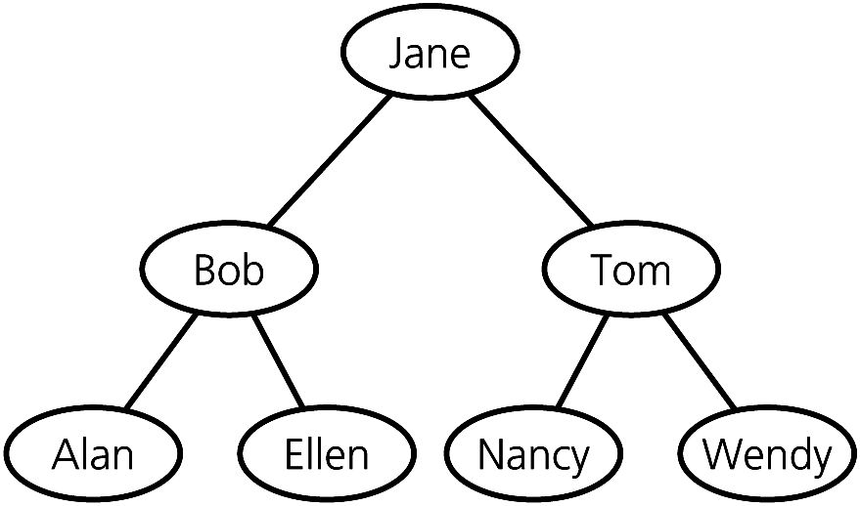
5. Binary Search Trees
A binary search tree is a binary tree that is ordered
i.e values in the left subtree < value of parent
values in the right subtree > value of parent

Slide 24
Binary Search Trees - Operations
Typical Operations of a Binary Search Tree
Search
Insert
Delete
Traversal

Slide 25
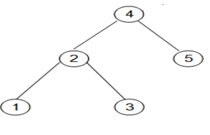

Searching an item in a Binary Search Tree
Search : 5
go left
go right

Slide 26
Search - Algorithm
BinaryNode* search(BinaryNode *t, ItemType target)
If (t is empty) // item not found return null Else If (item in t == target) // item found return t Else if (target < item in t) return search (left subtree of t, target) // search left subtree else return search (right subtree of t, target) // search right subtree

Slide 27
Search - Implementation
BinaryNode* search(BinaryNode* t, ItemType target)
{
if (t == NULL) // item not found
return NULL;
else
{
if (t->item == target) // item found
return t;
else
if (target < t->item) // search in left subtree
return search(t->left, target);
else // search in right subtree
return search(t->right, target);
}
}

Slide 28
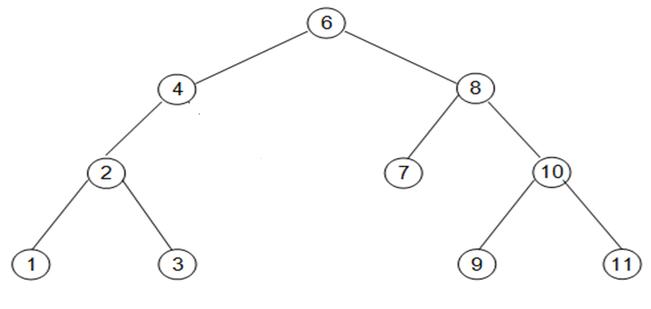
Inserting an item to a Binary Search Tree
Insert : 5
null
Search for the item (pointer will point to null)
Create a new node to store the item
Set the pointer pointing to null to point to new node

Slide 29
Insert - Algorithm
void insert(BinaryNode* &t, ItemType item)
If (t is empty) create a new node store the item in new node assign the new node to t; Else If (item < t->item) insert(t->left, item); // insert in left subtree Else insert(t->right, item); // insert in right subtree

Slide 30
Insert - Implementation
void insert(BinaryNode* &t, ItemType item)
{
if (t == NULL)
{
BinaryNode *newNode = new BinaryNode;
newNode->item = item;
newNode->left = NULL;
newNode->right = NULL;
t = newNode;
}
else
if (item < t->item)
insert(t->left, item); // insert in left subtree
else
insert(t->right, item); // insert in right subtree
}

Slide 31
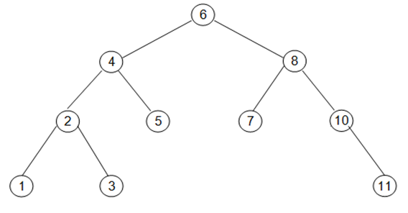
Deleting an item from a Binary Search Tree
Search for the node to be deleted
Case 1 : node to be deleted has 0 child (is a leaf)
Case 2 : node to be deleted has 1 child
Case 3 : node to be deleted has 2 children

Slide 32
Case 1 - deleting a leaf node
Simply delete the node by setting the pointer pointing to it to point to NULL.
i.e. if node to be deleted is the left child, then set the parent’s left child reference to null, otherwise set the parent’s right child reference to null

Slide 33
Case 2 - deleting a node with 1 child
Simply delete the node by setting the pointer pointing to it to point to the node’s child (only 1 child)
Notes:
If we delete 10, we make 8 right pointer point to 11

Slide 34
Case 3 - deleting a node with 2 children
1. find the successor (next smaller value)
i.e. the rightmost child in the node’s left subtree
2. Store the successor item in a temp variable
3. delete the successor recursively (either case 1 or case 2)
4. replace the node’s entry with that of the successor (in temp)
Notes:
1. If we delete 6, we find the next smallest value which is 5.
2. We store 5 into a temporary BinaryNode
3. We delete the child node with 5 recursively using case 1 or 2
4. Change the value of the root node with the temporary node value.

Slide 35
Delete - Algorithm
void remove(BinaryNode* &t, ItemType target)
Search for the node to be deleted If node to be deleted has 0 child (is a leaf) Simply delete the node by setting the pointer pointing to it to null. i.e. if node to be deleted is the left child, then set the parent’s left child reference to null, otherwise set parent’s right child reference to null else if node to be deleted has 1 child Simply delete the node by setting the pointer pointing to it to point to the node’s child (only 1 child) else (node to be deleted has 2 children) find the successor ( rightmost child in the node’s left subtree) Store the item in a temp variable remove the successor (either case 1 or case 2) // recursive replace the node’s item with that of the successor (in temp variable) * delete is a reserved word in C++

Slide 36
Delete - Implementation
void remove(BinaryNode* &t, ItemType target)
{
// refer to sample code on MEL
}

Slide 37
Summary
Introduction to Trees
Tree Terminology
Types of Trees
Binary Trees
Binary Tree Traversals
Binary Search Trees
Operations of a Binary Search Tree

